Slide 1

Intro to Robot Operating System
Sam Shue, PhD

Slide 2


Demo Code and Slides:

Slide 3

ROS Recap

Slide 4

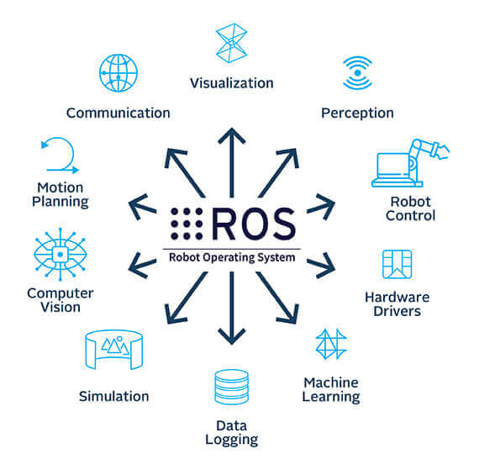
ROS (Robot Operating System) is a collection of software packages to make building complex robotics applications easier.
It provides things such as standardized formats for robot sensor data and motion commands, visualization tools, common algorithms, and simulators.

Slide 5
ROS (Robot Operating System) is a collection of software packages to make building complex robotics applications easier.
It provides things such as standardized formats for robot sensor data and motion commands, visualization tools, common algorithms, and simulators.

Slide 6
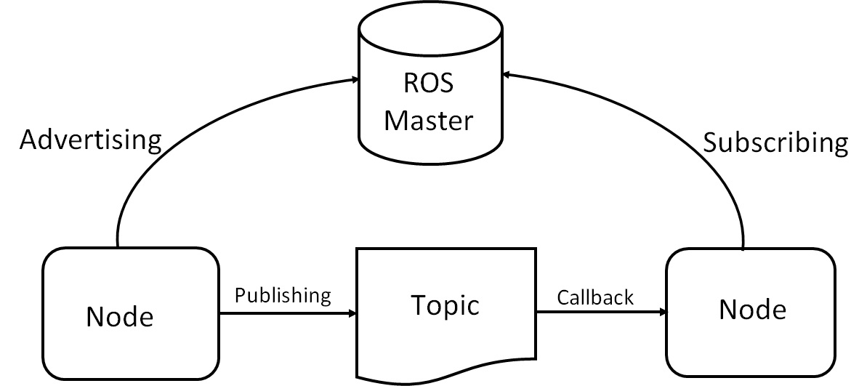
ROS achieves this standardization by providing a messaging system.

Slide 7
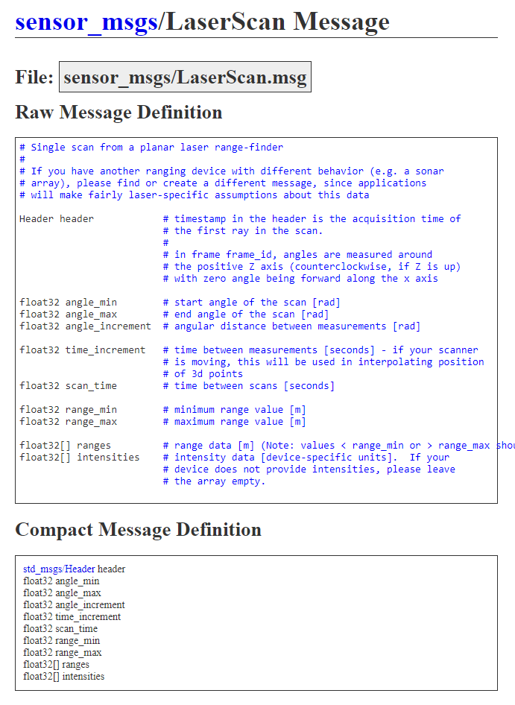

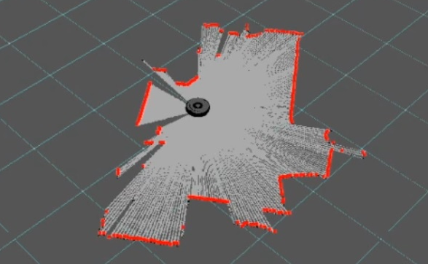
Publishers and Subscribers
Individual nodes will publish and subscribe to topics
Node that reads lidar data
Topic named “scan” that uses message type “laserscan”
Node that performs builds maps
/node_1
/node_2
Topic:
/scan
publishes
subscribes

Slide 8
Installing ROS

Slide 9
Installing ROS
It is recommended that you use Ubuntu for ROS 1:
Ubuntu 20.04: https://wiki.ros.org/noetic/Installation/Ubuntu
Ubuntu 18.04: https://wiki.ros.org/melodic/Installation/Ubuntu
Ubuntu 16.04: https://wiki.ros.org/kinetic/Installation/Ubuntu
Ubuntu 14.04: https://wiki.ros.org/indigo/Installation/Ubuntu
The latest Ubuntu LTS release is 22.04, which ROS 1 doesn’t support – this requires ROS 2

Slide 10
The ROS Workspace

Slide 11
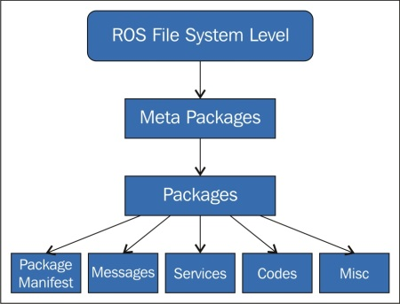
ROS files are organized into packages
Packages can contain nodes, message types, etc.

Slide 12
Packages must be built in order to run the nodes they contain using the command “rosrun”
Catkin is the build system used to build the code inside our packages into ROS nodes that we can run

Slide 13
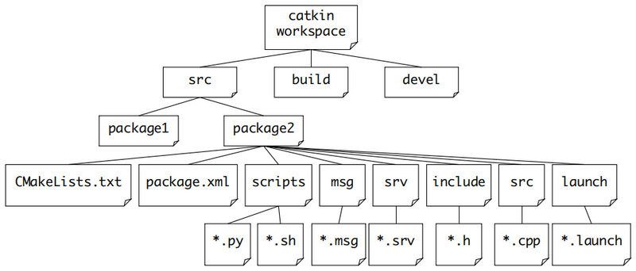
The Catkin build system is organized as follows:

Slide 14
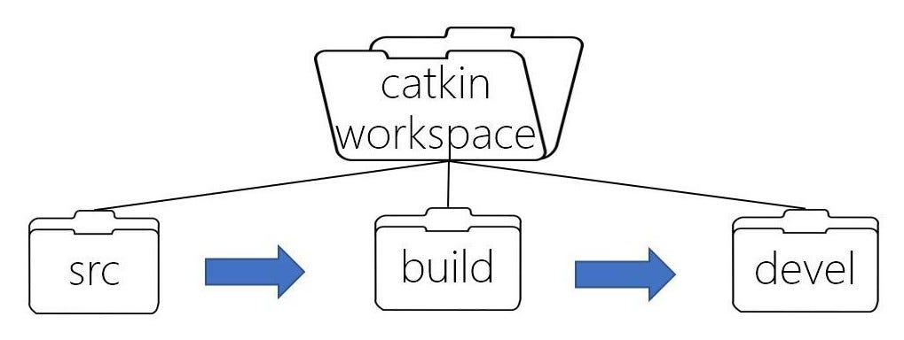
The Catkin build process takes the items in the “src” directory, builds them in the “build” directory, then the built files (executables) are stored in the “devel” directory

Slide 15
Create the Catkin Workspace
mkdir –p ~/catkin_workspace/src
cd ~/catkin_workspace catkin_make
Source the Catkin Workspace
This will execute the setup script which will make the contents of our workspace “known to ROS”
Source ~/catkin_workspace/devel/setup.bash
Notes:
catkin/Tutorials/create_a_workspace - ROS Wiki

Slide 16
Make a Catkin Package
In a catkin workspace’s “src” directory, run:
This will make a package called “beginner_tutorials”
This package has dependencies on
std_msgs – contains basic message types, such as ints, strings, etc.
geometry_msgs – contains the “twist” message used to send velocity commands
sensor_msgs – contains the “laserscan” message used with lidar data
rospy – the ros python client library
catkin_create_pkg beginner_tutorials std_msgs geometry_msgs sensor_msgs rospy
Notes:
ROS/Tutorials/CreatingPackage - ROS Wiki

Slide 17
To make our newly created package recognizable by ROS, we need to run the setup.bash script in the “devel” folder:
Now we can quickly go into our new package using the following command:
source ~/catkin_workspace/devel/setup.bash
roscd beginner_tutorials
Notes:
ROS/Tutorials/CreatingPackage - ROS Wiki

Slide 18
Now that the package is in place, we can start writing python scripts that will become our ROS nodes.
Let’s make a folder to hold our first script:
Inside that folder let’s make the script:
mkdir scripts
cd scripts
touch talker.py
Notes:
ROS/Tutorials/CreatingPackage - ROS Wiki

Slide 19
Inside our newly created “talker.py” script, we will populate it with the code to the right.
This code will publish some string (text) content to a topic called “chatter” periodically
#!/usr/bin/env python
import rospy
from std_msgs.msg import String
def talker():
pub = rospy.Publisher('chatter', String, queue_size=10)
rospy.init_node('talker', anonymous=True)
rate = rospy.Rate(10) # 10hz
while not rospy.is_shutdown():
hello_str = "hello world %s" % rospy.get_time()
rospy.loginfo(hello_str)
pub.publish(hello_str)
rate.sleep()
if __name__ == '__main__':
try:
talker()
except rospy.ROSInterruptException:
pass
Notes:
ROS/Tutorials/CreatingPackage - ROS Wiki

Slide 20
Understanding the Talker.py Node

Slide 21
Let’s examine the code line by line.
Every Python ROS Node will have this declaration at the top.
The first line makes sure your script is executed as a Python script.
#!/usr/bin/env python
import rospy
from std_msgs.msg import String
def talker():
pub = rospy.Publisher('chatter', String, queue_size=10)
rospy.init_node('talker', anonymous=True)
rate = rospy.Rate(10) # 10hz
while not rospy.is_shutdown():
hello_str = "hello world %s" % rospy.get_time()
rospy.loginfo(hello_str)
pub.publish(hello_str)
rate.sleep()
if __name__ == '__main__':
try:
talker()
except rospy.ROSInterruptException:
pass
Notes:
ROS/Tutorials/CreatingPackage - ROS Wiki

Slide 22
You need to import rospy if you are writing a ROS Node.
The std_msgs.msg import is so that we can reuse the String message type for publishing.
#!/usr/bin/env python
import rospy
from std_msgs.msg import String
def talker():
pub = rospy.Publisher('chatter', String, queue_size=10)
rospy.init_node('talker', anonymous=True)
rate = rospy.Rate(10) # 10hz
while not rospy.is_shutdown():
hello_str = "hello world %s" % rospy.get_time()
rospy.loginfo(hello_str)
pub.publish(hello_str)
rate.sleep()
if __name__ == '__main__':
try:
talker()
except rospy.ROSInterruptException:
pass
Notes:
ROS/Tutorials/CreatingPackage - ROS Wiki

Slide 23
This section of code defines the talker's interface to the rest of ROS.
pub = rospy.Publisher("chatter", String, queue_size=10) declares that your node is publishing to the chatter topic using the message type String.
#!/usr/bin/env python
import rospy
from std_msgs.msg import String
def talker():
pub = rospy.Publisher('chatter', String, queue_size=10)
rospy.init_node('talker', anonymous=True)
rate = rospy.Rate(10) # 10hz
while not rospy.is_shutdown():
hello_str = "hello world %s" % rospy.get_time()
rospy.loginfo(hello_str)
pub.publish(hello_str)
rate.sleep()
if __name__ == '__main__':
try:
talker()
except rospy.ROSInterruptException:
pass
Notes:
ROS/Tutorials/CreatingPackage - ROS Wiki

Slide 24
This section of code defines the talker's interface to the rest of ROS.
pub = rospy.Publisher("chatter", String, queue_size=10) declares that your node is publishing to the chatter topic using the message type String.
#!/usr/bin/env python
import rospy
from std_msgs.msg import String
def talker():
pub = rospy.Publisher('chatter', String, queue_size=10)
rospy.init_node('talker', anonymous=True)
rate = rospy.Rate(10) # 10hz
while not rospy.is_shutdown():
hello_str = "hello world %s" % rospy.get_time()
rospy.loginfo(hello_str)
pub.publish(hello_str)
rate.sleep()
if __name__ == '__main__':
try:
talker()
except rospy.ROSInterruptException:
pass
Notes:
ROS/Tutorials/CreatingPackage - ROS Wiki

Slide 25
The next line, rospy.init_node(NAME, ...), is very important as it tells rospy the name of your node
Until rospy has this information, it cannot start communicating with the ROS Master.
anonymous = True ensures that your node has a unique name by adding random numbers to the end of NAME.
#!/usr/bin/env python
import rospy
from std_msgs.msg import String
def talker():
pub = rospy.Publisher('chatter', String, queue_size=10)
rospy.init_node('talker', anonymous=True)
rate = rospy.Rate(10) # 10hz
while not rospy.is_shutdown():
hello_str = "hello world %s" % rospy.get_time()
rospy.loginfo(hello_str)
pub.publish(hello_str)
rate.sleep()
if __name__ == '__main__':
try:
talker()
except rospy.ROSInterruptException:
pass
Notes:
ROS/Tutorials/CreatingPackage - ROS Wiki

Slide 26
This line creates a Rate object rate.
With the help of its method sleep(), it offers a convenient way for looping at the desired rate.
With its argument of 10, we should expect to go through the loop 10 times per second.
#!/usr/bin/env python
import rospy
from std_msgs.msg import String
def talker():
pub = rospy.Publisher('chatter', String, queue_size=10)
rospy.init_node('talker', anonymous=True)
rate = rospy.Rate(10) # 10hz
while not rospy.is_shutdown():
hello_str = "hello world %s" % rospy.get_time()
rospy.loginfo(hello_str)
pub.publish(hello_str)
rate.sleep()
if __name__ == '__main__':
try:
talker()
except rospy.ROSInterruptException:
pass
Notes:
ROS/Tutorials/CreatingPackage - ROS Wiki

Slide 27
This loop is a fairly standard rospy construct:
checking the rospy.is_shutdown() flag and then doing work.
The "work" is a call to pub.publish(hello_str) that publishes a string to our chatter topic.
The loop calls rate.sleep(), which sleeps just long enough to maintain the desired rate through the loop.
#!/usr/bin/env python
import rospy
from std_msgs.msg import String
def talker():
pub = rospy.Publisher('chatter', String, queue_size=10)
rospy.init_node('talker', anonymous=True)
rate = rospy.Rate(10) # 10hz
while not rospy.is_shutdown():
hello_str = "hello world %s" % rospy.get_time()
rospy.loginfo(hello_str)
pub.publish(hello_str)
rate.sleep()
if __name__ == '__main__':
try:
talker()
except rospy.ROSInterruptException:
pass
Notes:
ROS/Tutorials/CreatingPackage - ROS Wiki

Slide 28
This loop is a fairly standard rospy construct:
checking the rospy.is_shutdown() flag and then doing work.
The "work" is a call to pub.publish(hello_str) that publishes a string to our chatter topic.
The loop calls rate.sleep(), which sleeps just long enough to maintain the desired rate through the loop.
#!/usr/bin/env python
import rospy
from std_msgs.msg import String
def talker():
pub = rospy.Publisher('chatter', String, queue_size=10)
rospy.init_node('talker', anonymous=True)
rate = rospy.Rate(10) # 10hz
while not rospy.is_shutdown():
hello_str = "hello world %s" % rospy.get_time()
rospy.loginfo(hello_str)
pub.publish(hello_str)
rate.sleep()
if __name__ == '__main__':
try:
talker()
except rospy.ROSInterruptException:
pass
Notes:
ROS/Tutorials/CreatingPackage - ROS Wiki

Slide 29
In addition to the standard Python __main__ check, this catches a rospy.ROSInterruptException exception, which can be thrown by rospy.sleep() and rospy.Rate.sleep() methods when Ctrl-C is pressed or your Node is otherwise shutdown.
The reason this exception is raised is so that you don't accidentally continue executing code after the sleep().
#!/usr/bin/env python
import rospy
from std_msgs.msg import String
def talker():
pub = rospy.Publisher('chatter', String, queue_size=10)
rospy.init_node('talker', anonymous=True)
rate = rospy.Rate(10) # 10hz
while not rospy.is_shutdown():
hello_str = "hello world %s" % rospy.get_time()
rospy.loginfo(hello_str)
pub.publish(hello_str)
rate.sleep()
if __name__ == '__main__':
try:
talker()
except rospy.ROSInterruptException:
pass
Notes:
ROS/Tutorials/CreatingPackage - ROS Wiki

Slide 30
Building and Running the Talker Node

Slide 31
We will need to add the following to the “CMakeLists.txt” file.
This makes sure the python script gets installed properly, and uses the right python interpreter
We will also need to make sure that the “talker.py” script has executable permissions by calling “chmod +x talker.py”
catkin_install_python(PROGRAMS scripts/talker.py
DESTINATION ${CATKIN_PACKAGE_BIN_DESTINATION}
)
Notes:
ROS/Tutorials/CreatingPackage - ROS Wiki

Slide 32
Return to the “catkin_workspace” directory to build the code using:
To run the node, call:
catkin_make
rosrun beginner_tutorials talker.py
Notes:
ROS/Tutorials/CreatingPackage - ROS Wiki

Slide 33
Building a Subscriber Node

Slide 34
Now let’s build a node to subscribe to our talker node’s chatter topic.
In the scripts folder, call:
touch listener.py
Notes:
ROS/Tutorials/CreatingPackage - ROS Wiki

Slide 35
Inside our newly created “listener.py” script, we will populate it with the code to the right.
This code will subscribe to the chatter topic and log what it receives.
#!/usr/bin/env python
import rospy
from std_msgs.msg import String
def callback(data):
rospy.loginfo(rospy.get_caller_id() + "I heard %s", data.data)
def listener():
rospy.init_node('listener', anonymous=True)
rospy.Subscriber("chatter", String, callback)
rospy.spin()
if __name__ == '__main__':
listener()
Notes:
ROS/Tutorials/CreatingPackage - ROS Wiki

Slide 36
Understanding the listener.py Code

Slide 37
The code for listener.py is similar to talker.py, except we've introduced a new callback-based mechanism for subscribing to messages.
#!/usr/bin/env python
import rospy
from std_msgs.msg import String
def callback(data):
rospy.loginfo(rospy.get_caller_id() + "I heard %s", data.data)
def listener():
rospy.init_node('listener', anonymous=True)
rospy.Subscriber("chatter", String, callback)
rospy.spin()
if __name__ == '__main__':
listener()
Notes:
ROS/Tutorials/CreatingPackage - ROS Wiki

Slide 38
This declares that your node subscribes to the chatter topic which is of type String.
When new messages are received, callback is invoked with the message as the first argument.
#!/usr/bin/env python
import rospy
from std_msgs.msg import String
def callback(data):
rospy.loginfo(rospy.get_caller_id() + "I heard %s", data.data)
def listener():
rospy.init_node('listener', anonymous=True)
rospy.Subscriber("chatter", String, callback)
rospy.spin()
if __name__ == '__main__':
listener()
Notes:
ROS/Tutorials/CreatingPackage - ROS Wiki

Slide 39
The final addition, rospy.spin() simply keeps your node from exiting until the node has been shutdown.
#!/usr/bin/env python
import rospy
from std_msgs.msg import String
def callback(data):
rospy.loginfo(rospy.get_caller_id() + "I heard %s", data.data)
def listener():
rospy.init_node('listener', anonymous=True)
rospy.Subscriber("chatter", String, callback)
rospy.spin()
if __name__ == '__main__':
listener()
Notes:
ROS/Tutorials/CreatingPackage - ROS Wiki

Slide 40
The callback function at the top is called anytime a new message on the topic arrives.
This function was associated with the topic when we initialized the subscriber.
#!/usr/bin/env python
import rospy
from std_msgs.msg import String
def callback(data):
rospy.loginfo(rospy.get_caller_id() + "I heard %s", data.data)
def listener():
rospy.init_node('listener', anonymous=True)
rospy.Subscriber("chatter", String, callback)
rospy.spin()
if __name__ == '__main__':
listener()
Notes:
ROS/Tutorials/CreatingPackage - ROS Wiki

Slide 41
Building and Running the Listener Node

Slide 42
We will need to edit the “CMakeLists.txt” file to include:
Once again, we will also need to make sure that the “listener.py” script has executable permissions by calling “chmod +x listener.py”
catkin_install_python(PROGRAMS scripts/talker.py scripts/listener.py
DESTINATION ${CATKIN_PACKAGE_BIN_DESTINATION}
)
Notes:
ROS/Tutorials/CreatingPackage - ROS Wiki

Slide 43
Return to the “catkin_workspace” directory to build the code using:
To run the node, call:
catkin_make
rosrun beginner_tutorials listener.py
Notes:
ROS/Tutorials/CreatingPackage - ROS Wiki

Slide 44
Building the wandering robot code

Slide 45
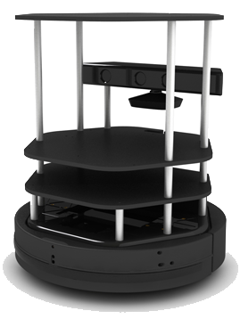
Next, we’ll write a python node to create a robot that wanders around its environment randomly, avoiding obstacles.
We’ll use the laser scan topic to get information about obstacles near the front of the robot.
Notes:
ROS/Tutorials/CreatingPackage - ROS Wiki

Slide 46
#!/usr/bin/env python
import rospy
import math
from sensor_msgs.msg import LaserScan
from geometry_msgs.msg import Twist
min_distance = None
def callback(laser_scan_msg):
global min_distance
if not laser_scan_msg.ranges:
return
min_distance = None
for distance in laser_scan_msg.ranges:
if not math.isnan(distance):
if distance < min_distance or min_distance == None:
min_distance = distance
def wanderer():
rospy.init_node('wanderer', anonymous=True)
rospy.Subscriber('scan', LaserScan, callback)
cmd_vel_pub = rospy.Publisher('/cmd_vel_mux/input/teleop', Twist, queue_size=10)
rate = rospy.Rate(100)
while not rospy.is_shutdown():
twist_cmd = Twist()
print min_distance
if min_distance < 0.5:
twist_cmd.angular.z = 1.0
for i in range(25):
cmd_vel_pub.publish(twist_cmd)
rospy.sleep(0.1)
twist_cmd.angular.z = 0.0
cmd_vel_pub.publish(twist_cmd)
else:
twist_cmd.linear.x = 0.25
cmd_vel_pub.publish(twist_cmd)
rate.sleep()
if __name__ == '__main__':
try:
wanderer()
except rospy.ROSInterruptException:
pass
This code will create a node that subscribes to the laser scan of the turtlebot and publishes to the command velocity topic to drive the robot around.
This code will drive the robot straight until an obstacle is encountered, then it will turn for some amount of time, and continue driving straight again.
Notes:
ROS/Tutorials/CreatingPackage - ROS Wiki

Slide 47
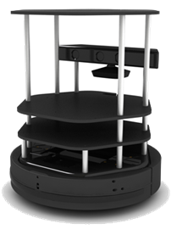
#!/usr/bin/env python
import rospy
import math
from sensor_msgs.msg import LaserScan
from geometry_msgs.msg import Twist
min_distance = None
def callback(laser_scan_msg):
global min_distance
if not laser_scan_msg.ranges:
return
min_distance = None
for distance in laser_scan_msg.ranges:
if not math.isnan(distance):
if distance < min_distance or min_distance == None:
min_distance = distance
def wanderer():
rospy.init_node('wanderer', anonymous=True)
rospy.Subscriber('scan', LaserScan, callback)
cmd_vel_pub = rospy.Publisher('/cmd_vel_mux/input/teleop', Twist, queue_size=10)
rate = rospy.Rate(100)
while not rospy.is_shutdown():
twist_cmd = Twist()
print min_distance
if min_distance < 0.5:
twist_cmd.angular.z = 1.0
for i in range(25):
cmd_vel_pub.publish(twist_cmd)
rospy.sleep(0.1)
twist_cmd.angular.z = 0.0
cmd_vel_pub.publish(twist_cmd)
else:
twist_cmd.linear.x = 0.25
cmd_vel_pub.publish(twist_cmd)
rate.sleep()
if __name__ == '__main__':
try:
wanderer()
except rospy.ROSInterruptException:
pass
This line of code imports the laserscan message type.
The “LaserScan” message contains lidar distance measurements from a 2-D sweep in front of the robot.
Notes:
ROS/Tutorials/CreatingPackage - ROS Wiki

Slide 48
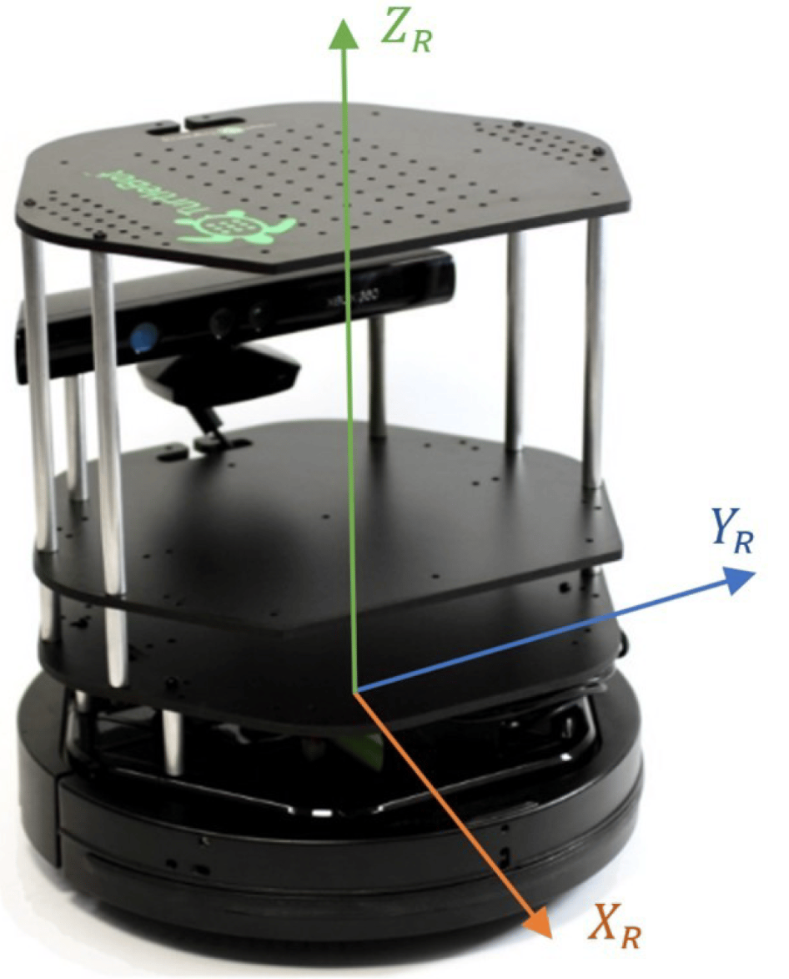
#!/usr/bin/env python
import rospy
import math
from sensor_msgs.msg import LaserScan
from geometry_msgs.msg import Twist
min_distance = None
def callback(laser_scan_msg):
global min_distance
if not laser_scan_msg.ranges:
return
min_distance = None
for distance in laser_scan_msg.ranges:
if not math.isnan(distance):
if distance < min_distance or min_distance == None:
min_distance = distance
def wanderer():
rospy.init_node('wanderer', anonymous=True)
rospy.Subscriber('scan', LaserScan, callback)
cmd_vel_pub = rospy.Publisher('/cmd_vel_mux/input/teleop', Twist, queue_size=10)
rate = rospy.Rate(100)
while not rospy.is_shutdown():
twist_cmd = Twist()
print min_distance
if min_distance < 0.5:
twist_cmd.angular.z = 1.0
for i in range(25):
cmd_vel_pub.publish(twist_cmd)
rospy.sleep(0.1)
twist_cmd.angular.z = 0.0
cmd_vel_pub.publish(twist_cmd)
else:
twist_cmd.linear.x = 0.25
cmd_vel_pub.publish(twist_cmd)
rate.sleep()
if __name__ == '__main__':
try:
wanderer()
except rospy.ROSInterruptException:
pass
The “Twist” message is used to provide linear and rotational velocities
Rotational velocities are provided around the z axis to make the robot turn in place
Linear velocities are provided along the x axis to make the robot drive forward
Notes:
ROS/Tutorials/CreatingPackage - ROS Wiki

Slide 49
#!/usr/bin/env python
import rospy
import math
from sensor_msgs.msg import LaserScan
from geometry_msgs.msg import Twist
min_distance = None
def callback(laser_scan_msg):
global min_distance
if not laser_scan_msg.ranges:
return
min_distance = None
for distance in laser_scan_msg.ranges:
if not math.isnan(distance):
if distance < min_distance or min_distance == None:
min_distance = distance
def wanderer():
rospy.init_node('wanderer', anonymous=True)
rospy.Subscriber('scan', LaserScan, callback)
cmd_vel_pub = rospy.Publisher('/cmd_vel_mux/input/teleop', Twist, queue_size=10)
rate = rospy.Rate(100)
while not rospy.is_shutdown():
twist_cmd = Twist()
print min_distance
if min_distance < 0.5:
twist_cmd.angular.z = 1.0
for i in range(25):
cmd_vel_pub.publish(twist_cmd)
rospy.sleep(0.1)
twist_cmd.angular.z = 0.0
cmd_vel_pub.publish(twist_cmd)
else:
twist_cmd.linear.x = 0.25
cmd_vel_pub.publish(twist_cmd)
rate.sleep()
if __name__ == '__main__':
try:
wanderer()
except rospy.ROSInterruptException:
pass
Our main function will call the “wander” function, which will execute our desired behavior on a loop.
At the beginning of this function, we set up subscribers and publishers to the topics for laserscan and command velocities
Notes:
ROS/Tutorials/CreatingPackage - ROS Wiki

Slide 50
#!/usr/bin/env python
import rospy
import math
from sensor_msgs.msg import LaserScan
from geometry_msgs.msg import Twist
min_distance = None
def callback(laser_scan_msg):
global min_distance
if not laser_scan_msg.ranges:
return
min_distance = None
for distance in laser_scan_msg.ranges:
if not math.isnan(distance):
if distance < min_distance or min_distance == None:
min_distance = distance
def wanderer():
rospy.init_node('wanderer', anonymous=True)
rospy.Subscriber('scan', LaserScan, callback)
cmd_vel_pub = rospy.Publisher('/cmd_vel_mux/input/teleop', Twist, queue_size=10)
rate = rospy.Rate(100)
while not rospy.is_shutdown():
twist_cmd = Twist()
print min_distance
if min_distance < 0.5:
twist_cmd.angular.z = 1.0
for i in range(25):
cmd_vel_pub.publish(twist_cmd)
rospy.sleep(0.1)
twist_cmd.angular.z = 0.0
cmd_vel_pub.publish(twist_cmd)
else:
twist_cmd.linear.x = 0.25
cmd_vel_pub.publish(twist_cmd)
rate.sleep()
if __name__ == '__main__':
try:
wanderer()
except rospy.ROSInterruptException:
pass
Every time we get a new laserscan message, the callback function will be called.
This function will loop through all distance measurements in the laserscan and record the minimum distance to a global variable.
Notes:
ROS/Tutorials/CreatingPackage - ROS Wiki

Slide 51
#!/usr/bin/env python
import rospy
import math
from sensor_msgs.msg import LaserScan
from geometry_msgs.msg import Twist
min_distance = None
def callback(laser_scan_msg):
global min_distance
if not laser_scan_msg.ranges:
return
min_distance = None
for distance in laser_scan_msg.ranges:
if not math.isnan(distance):
if distance < min_distance or min_distance == None:
min_distance = distance
def wanderer():
rospy.init_node('wanderer', anonymous=True)
rospy.Subscriber('scan', LaserScan, callback)
cmd_vel_pub = rospy.Publisher('/cmd_vel_mux/input/teleop', Twist, queue_size=10)
rate = rospy.Rate(100)
while not rospy.is_shutdown():
twist_cmd = Twist()
print min_distance
if min_distance < 0.5:
twist_cmd.angular.z = 1.0
for i in range(25):
cmd_vel_pub.publish(twist_cmd)
rospy.sleep(0.1)
twist_cmd.angular.z = 0.0
cmd_vel_pub.publish(twist_cmd)
else:
twist_cmd.linear.x = 0.25
cmd_vel_pub.publish(twist_cmd)
rate.sleep()
if __name__ == '__main__':
try:
wanderer()
except rospy.ROSInterruptException:
pass
Inside the wanderer function is a loop that will run as long as the node is active.
The loop will check the minimum distance recorded. If the minimum distance is less than 0.5 meters, then the robot will drive straight by publishing a twist message to the command velocity topic with a specified linear velocity.
Notes:
ROS/Tutorials/CreatingPackage - ROS Wiki

Slide 52
#!/usr/bin/env python
import rospy
import math
from sensor_msgs.msg import LaserScan
from geometry_msgs.msg import Twist
min_distance = None
def callback(laser_scan_msg):
global min_distance
if not laser_scan_msg.ranges:
return
min_distance = None
for distance in laser_scan_msg.ranges:
if not math.isnan(distance):
if distance < min_distance or min_distance == None:
min_distance = distance
def wanderer():
rospy.init_node('wanderer', anonymous=True)
rospy.Subscriber('scan', LaserScan, callback)
cmd_vel_pub = rospy.Publisher('/cmd_vel_mux/input/teleop', Twist, queue_size=10)
rate = rospy.Rate(100)
while not rospy.is_shutdown():
twist_cmd = Twist()
print min_distance
if min_distance < 0.5:
twist_cmd.angular.z = 1.0
for i in range(25):
cmd_vel_pub.publish(twist_cmd)
rospy.sleep(0.1)
twist_cmd.angular.z = 0.0
cmd_vel_pub.publish(twist_cmd)
else:
twist_cmd.linear.x = 0.25
cmd_vel_pub.publish(twist_cmd)
rate.sleep()
if __name__ == '__main__':
try:
wanderer()
except rospy.ROSInterruptException:
pass
If we detect a distance less than 0.5 meters, we will publish messages with a linear velocity of 0, to keep the robot from moving forward, and a rotational velocity of 1, to make the robot turn in place.
We have a small “for” loop to send this message out repeatedly for a small period of time. The base requires a stream of commands, otherwise it will stop moving.
Notes:
ROS/Tutorials/CreatingPackage - ROS Wiki

Slide 53
Thank You for Coming!
Questions?

